Slide 1
D
e
m
o
c
r
i
t
us
Moseley
Bohr
Thomson
Mendeleev
Rutherford
Heisenberg
Millikan
Plank
Dalton
deBroglie

Slide 2
ATOMIC THEORY
Atomic Theorists and their Contributions to the Atom

Slide 3
Atomic Theory: Timeline
460 BC: Democritus
1803: Dalton
1897: Thomson
1900: Planck
1909: Millikan
1911: Rutherford
1913: Bohr
1927: Heisenberg

Slide 4
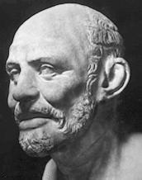
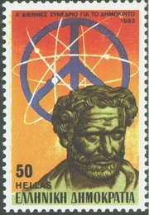
Democritus
460 BC
Greek philosopher
student of Leucippus
“atoms cannot be changed or destructed and everything we
see is made of clusters of atoms”
his ideas lacked experimental
support because scientific testing
was unknown at that time

Slide 5
Democritus
He and Leucippus coined the term atomos
Atomos means indivisible.

Slide 6
Aristotle
400 BC
another Greek philosopher
“Aristotle’s idea of atoms being made up of air, earth, wind, and fire were more popular than Democritus’ idea.
Democritus was on the right track, but since the ideas of Aristotle and others were followed, progress on learning more about the atom may have been delayed.

Slide 7
Wasted Time
From approximately 400 B.C. until the late 1700’s, there was not much progress made in regard to understanding more about the atom.
The Renaissance (Rebirth) Era promoted questioning and allowed scientific reasoning to flourish.

Slide 8
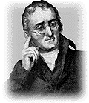
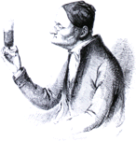
John Dalton
1766-1844
English schoolteacher
developed the first useful atomic theory of matter (in1803)
Dalton’s atomic theory includes five main postulates

Slide 9
Dalton’s Atomic Theory
The Basic Assumptions (Postulates): - Need to Memorize
All matter is composed of extremely small particles called atoms, which cannot be subdivided, created, or destroyed.
Atoms of a given element are identical in the physical and chemical properties.
Atoms of different elements differ in their physical and chemical properties.
Atoms of different elements combine in simple, whole-number ratios to form compounds
In chemical reactions, atoms are combined, separated, or rearranged but never created, destroyed, or changed.

Slide 10
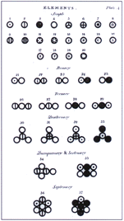
Dalton’s Table of Elements and their Combinations

Slide 11
Revisions to the Atomic Theory
Revisions to his theory
In “A” matter can be subdivided due to nuclear reactions
In “B” atoms have different properties due to isotopes (different neutrons)

Slide 12
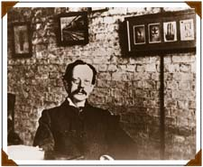
Sir J.J. Thomson
English physicist
discovered the electron (in 1897)
discovered that atoms are not indivisible
(Dalton’s Postulate Disproven)
used a cathode-ray tube to show that there are particles smaller than atoms (electrons)
created the “plum pudding
model”

Slide 13
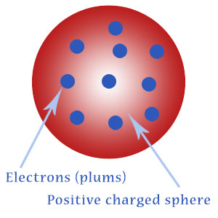
Thomson’s Plum Pudding Model
atoms are made of a sphere which is positively charged, with negatively-charged electrons “swimming” in this sphere
electrons = plums
positive interior = pudding

Slide 14
Thomson’s Cathode Ray Experiment
Thomson used cathode-ray tubes in his experiments:
1. gases under low pressure were sealed into glass tubes fitted at both ends with metal disks called electrodes
2. the electrodes were connected to a source of high-voltage electricity
3. one electrode, the anode, became positively charged; the other electrode, the cathode, became negatively charged.
4. a glowing beam formed between the electrodes – this beam, which traveled from the cathode to the anode is called the cathode ray. Cations (+) move toward the cathode, and anions (-) move away from the cathode.
5. Thomson found that the cathode rays were attracted to the positively-charged metal plates – plates that were negatively-charged repelled the cathode rays.

Slide 15
Thomson’s Experiment (cont.)
Thomson knew that opposite charges attract and like charges repel SO he proposed that a cathode ray is a stream of tiny negatively-charged particles moving at high speed
7. these negatively-charged particles were then named electrons
Thomson also showed that the production of cathode rays did not depend on the kind of gas in the cathode-ray tube or the type of metal used for the electrodes
he concluded that electrons must be parts of the atoms of all elements
by 1900, Thomson and others had determined that an electron’s mass is about 1/2000 the mass of a hydrogen atom

Slide 16
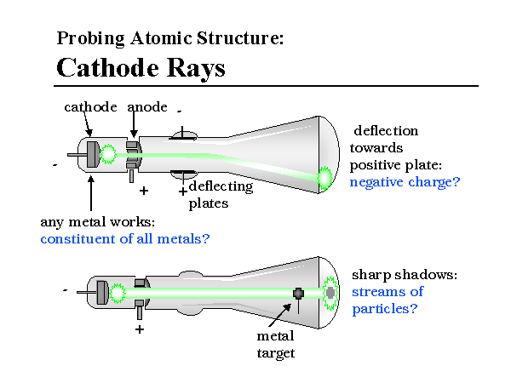
Credited with the discovery of the nucleus

Slide 17

Show Video

Slide 18
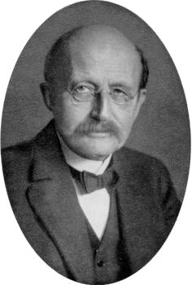
Max Planck
discovered the quantum nature of
energy (in 1900)
“energy does not flow in a steady continuum, but is delivered in discrete packets (particles) called quanta”
“quantum” is the amount of energy for an electron to jump to an energy level
Niels Bohr used Planck’s research
to develop his model of the atom

Slide 19
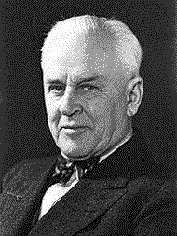
Robert Millikan
found the quantity of charge carried by an electron (in 1909)
determined the ratio of the charge to the mass of an electron
found the charge to mass ratio of the electron (in 1916)
American scientist
performed the famous
“oil-drop” experiment

Slide 20
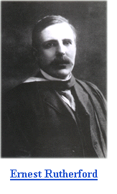
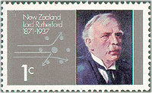
Ernest Rutherford
in 1911, discovered the atomic nucleus
a New Zealand physicist
“atoms have a positively-charged nucleus which is surrounded by negatively-charged particles”
suggested the so-called planetary model, which claims electrons orbit the nucleus just like planets orbit the Sun
performed his famous experiment with a thin golden foil

Slide 21
Rutherford’s Gold Foil Experiment
aimed a beam of alpha particles (+ charge) at a sheet of gold foil surrounded by a fluorescent screen
found that most of the particles passed through the foil with no deflection at all
a few particles were greatly deflected
CONCLUSION:
most of the alpha particles pass through the gold foil because the atom is mostly empty space
the mass and positive charge (protons discovered)are concentrated in a small region of the atom called the nucleus
particles that approach the nucleus closely are greatly deflected

Slide 22
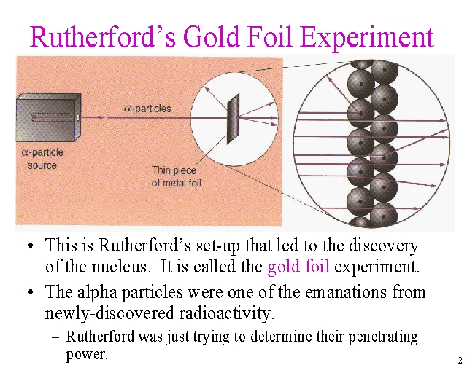

Slide 23
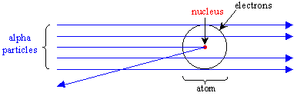

Slide 24
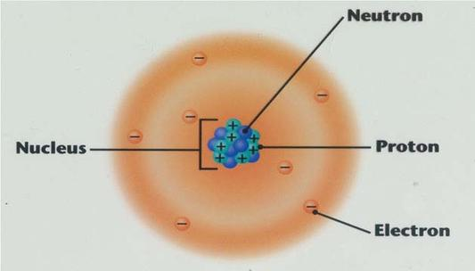
Flaw of the Rutherford Model
Draw picture for students on board

Slide 25
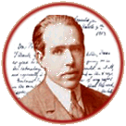
Niels Bohr
improved the “planetary model” by suggesting
that electrons only orbit the nucleus in
well-defined paths (in 1913)
depicted the atom as a small, positively-charged nucleus surrounded by electrons in orbit
“electrons travel in discrete orbits around the nucleus” Known as energy levels!
electrons orbiting an atom can only exist at certain energy levels (distances) from the nucleus, not at continuous levels as might be expected from Rutherford’s model
Danish physicist, was often called the “ladies’
man”,

Slide 26
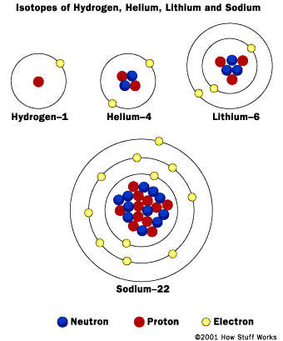
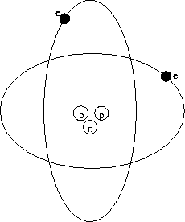

Slide 27
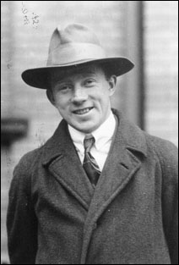
Werner Heisenberg
discovered the “uncertainty principle” (in 1927) – we really don’t know where electrons are at any time
electrons exist in certain orbits (Bohr), but we cannot pinpoint where they will be at a certain time
German physicist

Slide 28
Werner Heisenberg
Heisenberg Uncertainty Principle – We cannot know both the speed and position of an electron.

