Slide 1
Welcome to Mrs. J’s Class

Slide 2
MRS.J’s PROFILE
Teaching Experience
26years
Subject Taught
PHYSICS &
Chemistry

Slide 3
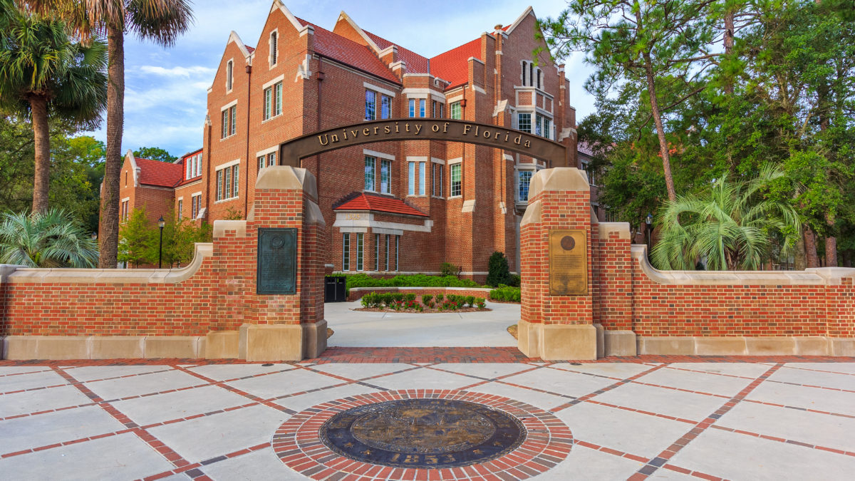
Educational Background
Double Bachelors
Majoring in Physics and Education (GPA 3.64)
University of Madras
Masters in Education
Majoring in Curriculum and Instruction (GPA 3.97)
University of Florida
Currently pursuing Doctorate in Education
Majoring in Curriculum and Instruction
University of Florida

Slide 4
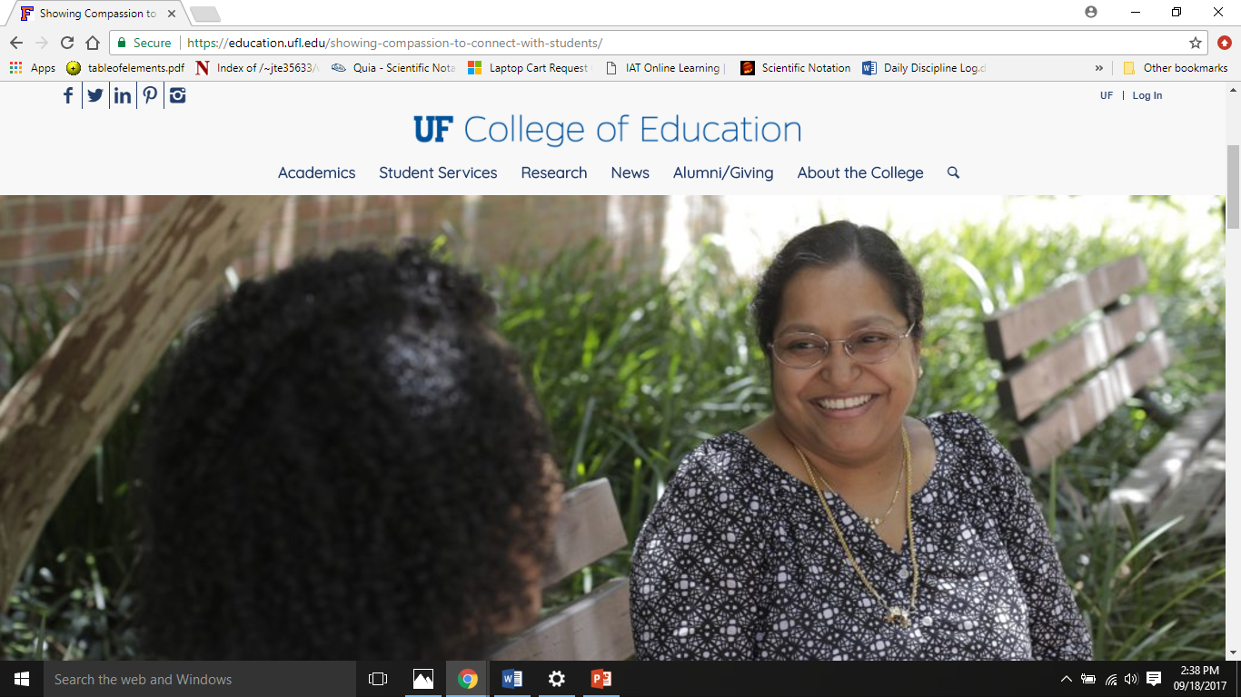
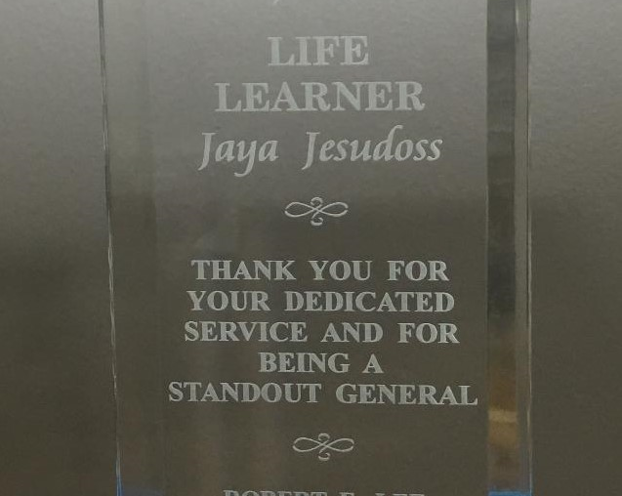
Distinctions and Recognitions
University First in Practical Physics, 1995
Life Learner Award 2015-2016
UF College of Education Recognition for an outstanding Alumni for the year 2015

Slide 5
Family
Husband
Daughter
Extended Family

Slide 6
IF YOU HAVE ANY
QUESTIONS ABOUT ME
FEEL FREE TO ASK.

Slide 7
Essential Class Supplies needed for this course
Loose notebook paper
A scientific calculator (Texas Instruments TI-30XIIS 10-Digit Scientific Calculator TI -30XII) will be a good one.
Device / laptop
Charger
#2 pencil, pen, and highlighter

Slide 8
My Website www.riversidechemistry.com
Students absent for class can access their work on this website. Unless, students complete their work, they CANNOT take the exit tickets or quizzes.
Also, there are helpful resources and practice tests. Please use it!

Slide 9
Homework
On a weekly basis, students will have homework . The work should not take more than 20-30 minutes.
All make-up and home work will be posted in my website.

Slide 10
GRADING POLICY
Labs/ Investigations / Classwork/ Homework/ Exit tickets (EEA) - 40%
Quizzes – 25%
Tests/ Projects - 35%

Slide 11
TUTORING
Tutoring will be held only through parent request and by appointments
Please don’t forget to get a tutoring pass.
No pass, No tutoring.

Slide 12
The Chemistry Textbook can be Accessed Online 24 X 7
URL address - http://ebook.iat.com
Username - Robert*Lee
Password - Chemistry1234
Note: Recommended browser is Mozilla Firefox and the username and password are case sensitive.

Slide 13
TO BE SUCCESSFUL IN CHEMISTRY
Attendance is crucial !!!
Or be proactive!!!

Slide 14
HAVE A GREAT START THIS YEAR!!!

Slide 15
Thanks for coming!!!
This Photo by Unknown Author is licensed under CC BY-SA

